Slide 1
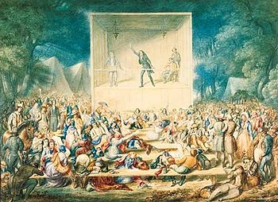
The Second Great Awakening

Slide 2
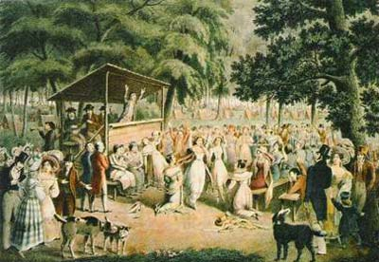
The Second Great Awakening
1820s and 1830s
Christian religious revivals mainly among Methodists, Presbyterians, and Baptists

Slide 3
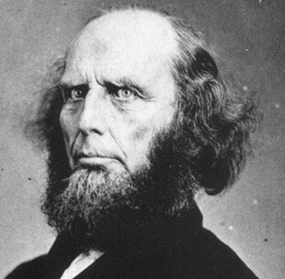
Charles Grandison Finney
Father of “revivalism”
Opponent of Old School Presbyterian theology
Advocate of “Christian perfectionism”
President of Oberlin College

Slide 4
Ideas
How is this different from the 1st Great Awakening?
The same?
People were “moral free agents” who could obtain salvation through their own efforts
Emphasis on personal improvement, avoidance of sin, and hard work

Slide 5
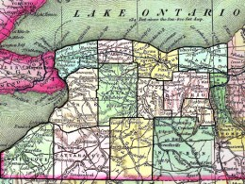
Where It All Started
Began in New York (the “Burned over District”) in the 1790s
Finney himself had a “conversion” experience in New York

Slide 6
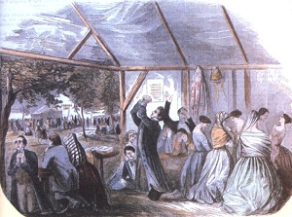
Methods
Characterized by evangelicalism
Revivals = camp meetings
Extemporaneous sermons
Public prayer meetings of mixed gender
Public criticism of individuals by name in sermons and prayers

Slide 7
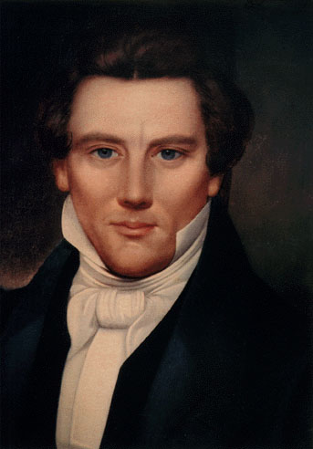
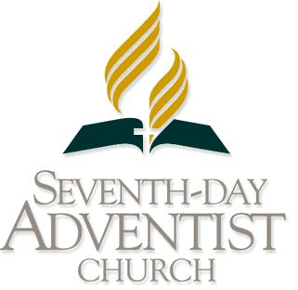
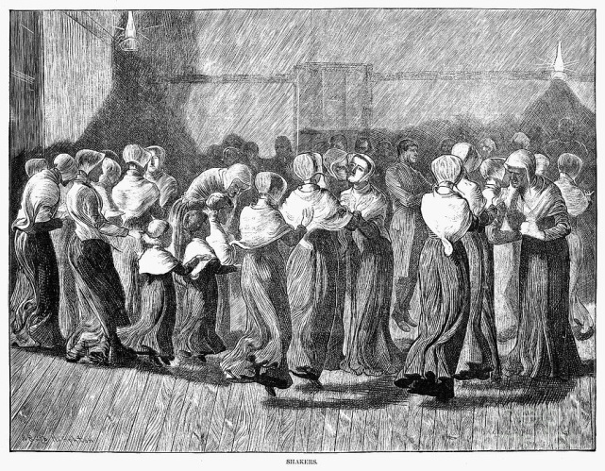
Results (So What)
Millions of new members recruited
New denominations (Mormons, Seventh Day Adventist, Shakers, Church of Christ)
People believed in the Second Coming of Christ
Remedy society’s ills before he returns

Slide 8
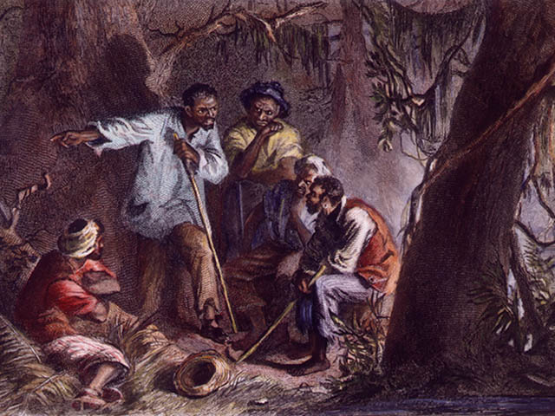
Results (So What)
Baptists and Methodists in the South preached to slaves, too
Led to establishment black churches
Led to slave rebellions (remember Nat Turner, 1831)
Inspired slaves to demand freedom

Slide 9
Results (So What)
Stimulated reform movements of the 1800s:
temperance
abolition
moral reform
public education
philanthropic endeavors
utopian movements

